Slide 1

Java Virtual Machine(JVM)
Cindy Chen, Julia Zinda, Cassie Sand, Logan Johansson

Slide 2

Team introduction
History of Java Cindy
Java Class file structure and bytecode Cindy
Java Memory Management Julia
Java implementations – Platforms / vendors Julia
What other languages compile to Java Bytecode Cassie
Android Implementation Cassie
JIT compile/execution Cassie
Performance comparison between C/C++ and Java with and without JIT Logan
Sample Java program with explanation of bytecode Logan
Notes:
Introduction of each team member and their responsible topics

Slide 3

Project introduction
Java Virtual Machine(JVM):
Java Virtual Machine is a virtual machine that enables computers to run java and non-java language programs
Java Virtual Machine is detailed by a specification that describes the JVM requirement implementations, allowing different programmers using the Java Development Kit(JDK) to not worry about any hardware platform issues
Java Virtual Machine is the cornerstone of the java platform. It is the component of hardware and operating system independence in technology programs. It contains instruction sets and manipulation of various memory usage at run time.
Java Virtual Machine is first implemented by Sun Microsystems Inc., hosted by handheld device software that resembled a contemporary Personal Digital Assistant(PDA)
The newest model is hosted by Oracle's implementations on mobile, desktop, and server devices. It can be implemented by compiling its instruction set to that of a silicon CPU. It can also be implemented in microcode or directly into silicon.
Notes:
Quick introduction of JVM

Slide 4

History of Java

Slide 5

Java: the roots
FGFGFFG
Java was initially designed for interactive television, but it became overly advanced to accommodate the digital cable television industry at the time
Java was born in the early 1990s as Project "Oak", under a small team of engineers working for the Sun Microsystems Corporation. This team was leaded by James Gosling, whom was the "founding father of Java". The other members of the "Green Team" included Mike Sheridan, Patrick Naughton, and other engineers employed at Sun Microsystems Corporation.
The project name "Oak", originally came from an Oak tress outside of James Gosling's office. Oak tree represents images of solidarity, strength, and durability. It's proven that its name did emphasize the project's importance in modern society.
Goslin's goals were to implement a virtual machine and language similar of C-like syntaxes, with however, greater uniformity and simplicity than C/C++. His main motive was to implement object-oriented programming language, allowing programmers with previous C/C++ backgrounds to learn easier.
Notes:
Introduction of the Java foundation, where the growth/roots of Java beganed

Slide 6

Java: James Gosling
FGFGFFG
James Gosling is born in 05/19/1955, a Canadian computer scientist best known as the founder and lead designer of the Java programming language. Gosling attended the University of Calgary studying computer science and earned his M.A. and Ph.D. from Carnegie Mellon University all in computer science.
Before Gosling joining Sun Microsystems Corporation, he had built multi-processor versions of Unix for a 16-way computer system. He developed several compilers and mail systems while at Carnegie Mellon University.
Gosling was employed with Sun Microsystems Corporation from 1984 - 2010. At Sun Microsystems Corporation, he invented early Unix windowing system and was the father of the Java programming language
Gosling left Sun Microsystems Corporation on April 2nd, 2019, after the Oracle corporation acquisition. Gosling's decision into leaving the company originated in reduction of pay, status, decision-making abilities, changes of roles, and ethical challenges. Gosling has been critical regarding Oracle corporation's interviews, stating that the integration and transition between Sun Microsystems and Oracle Corporation has distributed more problems that was predicted.
After leaving Sun Microsystems Corporation, Gosling joined Google, then followed by his colleague Bill Vass to join a start up called Liquid Robotics. After acquisition by Boeing, Gosling left Liquid Robotics to work at Amazon Web Services as a distinguished engineer in May 2017.
Gosling's contribution to the Java programming language has earned him recognition in many engineering conferences. Gosling has earned many awards and named nominations from 2002- 2019
Notes:
Learn about the "Founding father" of Java, James Gosling

Slide 7

Java: Mike Sheridan
FGFGFFG
Mike graduated from Pitzer College with a degree in Political Science and worked at American University in Film and Video
Mike worked along the "Green Project" members at Sun Microsystems Corporation that conceived and developed the java programming language. While at Sun Microsystems Corporation, Sheridan worked on Java strategy and business development at with Sun Microsystems Corporation's Chief Technology Officer
Mike joined Novell in 1998 as the lead to new product and business opportunity development in the Novell Directory Services(NDS) and Novell's Intelligent Caching System. Mike identifies market opportunities for Novell technologies and invent new products, partnerships, and new lines of business.
Mike has a successful record of working with entrepreneurs and companies dedicated to building values and advancing technology innovations and applications. Mike brings a wealth of high-technology operations experiences and entrepreneurial expertise into companies' technologies.
Notes:
Learn about Mike Sheridan, one of the important programmers that formed Java

Slide 8

Java: Patrick Naughton
FGFGFFG
Patrick is an American software developer and one of the creators of the Java programming language
While at Sun Microsystems Corporation, Patrick became frustrated with the state of Sun's C++ and C API tools. Patrick worked with James and Mike onto the "Green Project", attempting to develop a new technology for programming next generation smart appliances.
Patrick graduated from Clarkson University
After leaving Sun Microsystems Corporation, Patrick joined Starwave to develop Java server applications for web sites. He then joined Walt Disney for the executive vice president position in 1998.
In 1999, Patrick violated laws and was found guilty of crime arrest. He served five years of probation and nine months of home detention, along with $20,000 fine.
There isn't any more information found in the internet of Patrick since arrest.
Notes:
Learn about Patrick Naughton, one of the important programmers that formed Java

Slide 9

Java: the goal
FGFGFFG
According to the developers, Java was developed with several core principles:
Simple,
Robust,
Portable,
Platform-independent,
Secured,
High Performance,
Multithreaded,
Architecture Neutral,
Object-Oriented,
Interpreted,
Dynamic.
While meeting the above core principles, developers also had five primary goals for developing this programming language:
Use the object-oriented programming methodology.
Support executing of the same code on multiple platforms and operating systems.
Built-in computer network support.
Allow secure execution of code from remote sources.
Be easy to learn and use.
Notes:
Explains the goals of Java, what the projected new language should do

Slide 10

Java: development
FGFGFFG
The development of the Java programming language was finished in 1995. Java was intended to be a write-once-run-everywhere capability along with easy accessibility of the software and internet communities to standardize writing applications for complex networks.
Java was based on the "Write once, run anywhere" promise, supporting free runtime son popular platforms.
Java comparing to C/C++, Java offers more security, configurations of security options, and limit access to certain networks and/or files.
Notes:
The development of Java

Slide 11
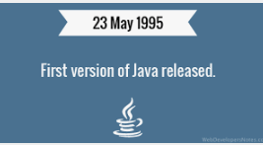
Java: first release
FGFGFFG
Prior to the release in 1995, the project was renamed from "Oak" to "Java", reasoning behind that the original name was already trademark by Oak Technologies. According to James Gosling, the "Green Project" team members had various options for its new programming language name, including Java, DNA, SILK, RUBY, Dynamic, Revolutionary, Jolt, and many others. Gosling decided to name the newly created language Java, while having a cup of coffee near his office. The name Java originates from a sort of espresso bean, part of the production of which comes from the island of Java.
In early 1996, Sun Microsystems Corporation released the first public implementation of Java 1.0. Sun Microsystems Corporation invited developers to download Java 1.0 to start building the next generation of killer applications.​
After the first release, all major web browsers incorporated the ability to run Java applets within web pages, which made Java one of the most mainstreamed technologies in internet programming.
Java has continuously improved since the first release, with new releases yearly, major changes were implemented within the new versions. Java 2 added multiple configurations built for different types of platforms, including APIs for enterprise applications, server environments, mobile applications, and more features modern internet has used.
Notes:
Explains the history of when Java was first created

Slide 12

Java: the new era
FGFGFFG
With the major release of Java 1.0, Java was named one of the "Ten Best Products of 1995" by the TIME Magazine
In November of 2006, Sun Microsystems Corporation released much of its Java Virtual Machine(JVM) as free and open-source software.
The Java language has experienced various augmentations of classes and packages to the standard library. In addition to the language changes, creating more sensational changes to the Java Class Library, Java has developed hundreds to thousands of classes in J2SE 5.
In May 2007, Java completed the process of making Java fully open sourced, by accessing Java Virtual Machine's core code.
In April 2009, Oracle Corporation acquired Sun Microsystems Corporation with its rights to the Java technologies developed within the Green Team. Oracle Corporation offered Sun Microsystems Corporation $5.6 billion in net of Sun's cash and debt.
Following the acquisition, James Gosling(the creator of Java), Tim Bray(the creator of XML), and couple members of the Sun Microsystems Corporation resigned and pursued other corporations
The biggest change in Java technologies under Oracle corporation came in 2017, when Oracle announced that Java will be moved to new versions of release launching every six months, as a way to ensure Java-related technologies are updated in timely manners matching modern-day market advancements.
Notes:
Explaination of the after java release

Slide 13
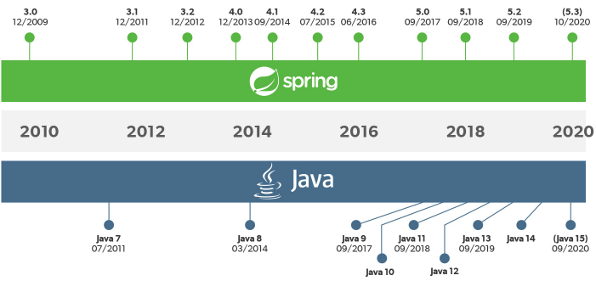
Java: the future
FGFGFFG
Today, Java is well-known as one of the most versatile programming languages in the world. Almost being used everywhere in terms of platforms, many additional features are added to the language. Now, Java is being used in Windows applications, Web applications, enterprise applications, mobile applications, cards, and much more......
Please see the attached link to learn more about new Java versions, releases, release date, and changes of the new release
Notes:
Java timeline

Slide 14

Java Class File Structure

Slide 15
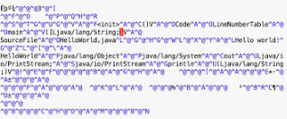
Java Class File
FGFGFFG
Java Class File: a file with the .class filename extension containing Java bytecode that can be executed on the Java Virtual Machine(JVM).
A Java class file is produced by a Java compiler from the Java programming language source file(.java files) containing Java classes. If a source file has more than one class, each class is compiled into a separate class file.
Java Virtual Machine(JVM) is available for many platforms, and a class file compiled from one platform will be executed on a Java Virtual Machine on another platform. Allowing Java applications to be independent from other platforms.
On December 11th of 2006, the Java Specification Request 202 modified class file format successfully.
A class file consists of 8-bit bytes. All 16-bit, 32-bit, and 64-bit are constructed by reading two, four, and eight consecutive 8-bit bytes. Multibyte data items are stored in big-endian order, where the high bytes comes first, and low bytes go last.
The contents of the structures describing the class file format are referred to as items, items are stored in the class file sequentially, without alignment or paddings.
Larger variable-sized items are stored in tables, are used in several class file structures.
Notes:
The file structure of java

Slide 16
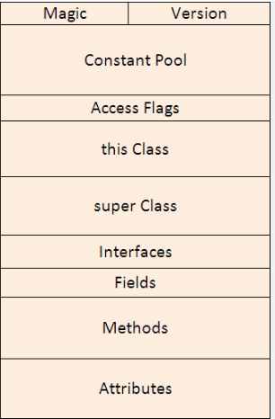
Java Class File Layout and Structure
FGFGFFG
Java Class File Structure contains 10 basic sections :
Magic Number
Version of Class File Format
Constant Pool
Access Flags
This Class
Super Class
Interfaces
Fields
Methods
Attributes
Notes:
The java class file of java

Slide 17
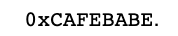
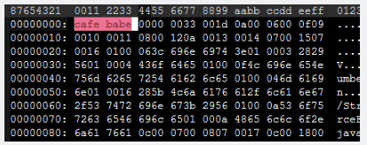
Magic Number
FGFGFFG
Class files are identified by the following 4 byte headers in hexadecimal: CA FE BA BE
The naming convention comes from the creator of Java James Gosling, referring to the restaurant in Palo Alto. Gosling was re-vamping some file format code and needed a couple of magic numbers, one for the persistent object file and one for classes. Gosling used CAFEDEAD for the object file format, for the 4 character hex words that fit after "CAFÉ", then decided to use "BABE". Gosling decided to go with "CADEBABE" for the class file format, and "CAFEDEAD" for the persistent for the object format, which was eventually replaced by "RMI".
Notes:
Slide deeply explains the concept of each level of the java file format class

Slide 18
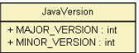
Version of Class File Format
FGFGFFG
The values of the minor_version and major_version items are the minor and major version numbers of this class file. Together, a major and a minor version number determines the version of the class file format.
A class file has a major version number M and minor version number m, we denote the version of its class file format as M.m. So the class file format versions may be ordered from lowest to largest, such as 1.5 < 2.0 < 2.6
Notes:
Slide deeply explains the concept of each level of the java file format class

Slide 19
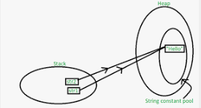
Constant Pool
FGFGFFG
Constant Pool: table of structures representing various string constants, class, interface names, field names, strings, identifier names, references to classes and methods, type descriptors, and other constants that are referred to within the ClassFile structure and its substructures.
The format of each Constant_pool table entry is indicated by its first "tag" byte. The Constant_pool table is indexed from 1 to Constant_pool_count – 1 .
Notes:
Slide deeply explains the concept of each level of the java file format class

Slide 20
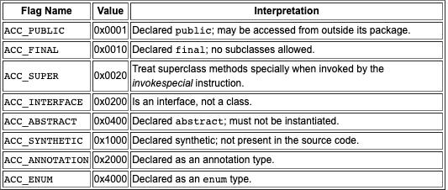
Access Flags
FGFGFFG
Access Flags: the value of the access_flags item is a mask of flags used to denote access permissions to and properties of this class or interface.
Notes:
Slide deeply explains the concept of each level of the java file format class

Slide 21
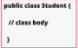
This Class
FGFGFFG
The value of the this_class item must be a valid index into the constant_pool table. The constant_pool entry at that index must be a constant_class_info structure, representing the class or interface defined by this class file
This class refers to the name of the current class
Notes:
Slide deeply explains the concept of each level of the java file format class

Slide 22
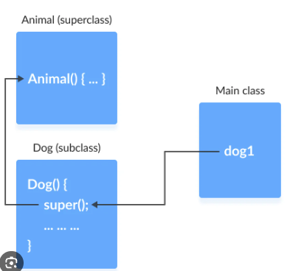
Super Class
FGFGFFG
The value of the super_class item either must be a zero or a valid index into the constant_pool table. If the value of the super_class item is nonzero, then the constant_pool entry at that index must a constant_class_info structure that represents the direct superclass of the class defined by this class file.
If the value of the super_class is zero, then the this class file will represent the class object, the only class or interface without a direct superclass.
For the interface, the value of the super_class item must always be a valid index into the constant_pool table. The entry at that index must be a constant_class_info structure representing the class object
Notes:
Slide deeply explains the concept of each level of the java file format class

Slide 23
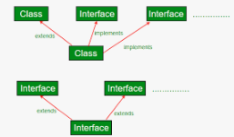
Interface
FGFGFFG
Each value in the interface array must be a valid index into th econstant_pool tbale. The entry at each value of interfaces[I], where 0< I < interfaces_count, must be a constant_class_info structure representing an interface that is the direct superinterface of another class or interface.
The value of the interface_count refers to the number of direct superinterfaces of this class or interface type.
Notes:
Slide deeply explains the concept of each level of the java file format class

Slide 24
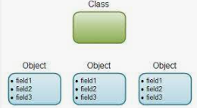
Fields
FGFGFFG
Each value in the fields table must be a field_info structure giving a complete description of a field in this class or interface.
The field table includes only those fields that are declared by the class or interface, it doesn't include items that represents fields that are inherited from superclasses or superinterfaces.
The fields_count refers to the number of field_info structure in the fields table, representing all fields, class variables, and instance variables declared by this class or interface type.
Notes:
Slide deeply explains the concept of each level of the java file format class

Slide 25
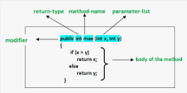
Methods
FGFGFFG
Each value in the methods table must be a method_info structure givng a complete description of a method in this class or interface.
The method_info structures represent all methods declared by its class or interface type, including instance methods, class methods, instance initialization methods, and all class or interface initialization methods. It doesn't include any items representing methods that are inherited from superclasses or superinterfaces.
The methods_count value refers to the number of method_info structures in the methods table
Notes:
Slide deeply explains the concept of each level of the java file format class

Slide 26
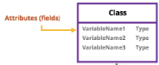
Attributes
FGFGFFG
Each value of the attributes table must be an attribute_info structure.
The Java Virtual Machine implementation is required to ignore any or all attributes in the attributes table of a ClassFile structure that doesn't recognize it. Attributes not defined in the specification are not allowed to affect the semantics of the class file, but only allowed to add additional descriptive information
Notes:
Slide deeply explains the concept of each level of the java file format class

Slide 27
Java Memory Management
FGFGFFG
Why is it important to understand?
How does it compare to other programming languages?
System divided into two parts
The JVM Memory Structure
The Garbage Collector
Notes:
-does not require a programmer to allocate and deallocate memory
-memory allocation is handled automatically (garbage collector)

Slide 28
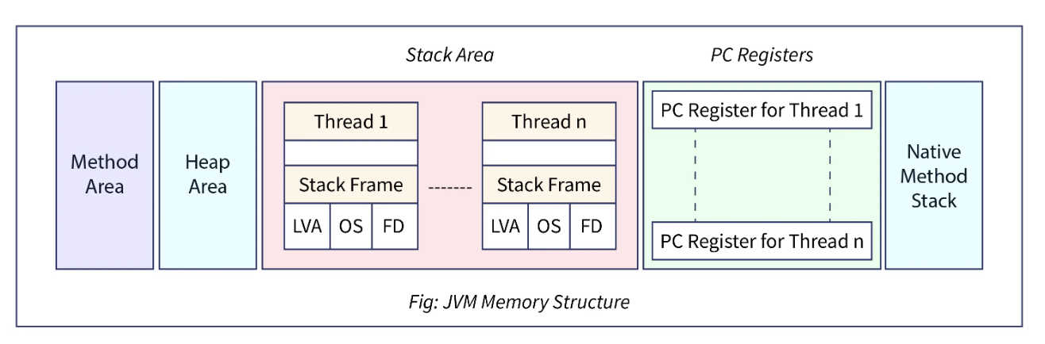
JVM Memory Structure Breakdown
FGFGFFG
Notes:
-JVM creates various run time data areas in heap
-memory areas are destroyed when JVM exits and data areas are destroyed when the thread exits

Slide 29
Java Memory Management – Method Area
FGFGFFG
A shared data area in the JVM that stores class and interface definitions
Responsible for holding class level information
Stores class structure, superclass name, interface name, and constructors
Fixed or dynamic size
Notes:
-JVM starts (creation of this area), JVM exits (destruction)
-considered part of the heap memory
-capable of size fluctuation.

Slide 30
Java Memory Management – Heap Area
FGFGFFG
Where the objects are created and kept
Person p = new Person("John", "Doe", 30);
Larger in size but slower than stack memory (discussed next)
Divided into three parts
The Young Generation
The Old Generation
The Permanent Generation
Notes:
-where actual objects are stored. When the 'new' keyword is used, the JVM creates an instance of the object in a heap
-Generally seen divided into three parts
-Young generation is where all the new objects are assigned
-Old generation is where long-lasting items are kept
-Permanent generation contains native and static methods. Not technically considered part of the heap, but important nonetheless.

Slide 31
Java Memory Management – Stack Area
FGFGFFG
Generated when a thread starts
Each thread has its allocation of stack memory
Values are stored directly, rather than in reference
The stack frame contains the thread's data for the current method
Grows and shrinks itself
Notes:
-The stack memory is allocated per thread and based on the last in, first out principle.
-Data and partial results are stored here, and values are held directly.
-The stack frame represents the state of the thread for the current method. When a method is invoked, a new frame is created. When a method completes, the frame is destroyed. Only when frame is active at any point.

Slide 32
Java Memory Management – PC Registers
FGFGFFG
PC (program counter)
Every thread has a program register associated with it
The register stores the return address, and contains the address of the current executing instructions
Few registers are needed
Notes:
-few registers are needed since the instructions operate primarily on the stack

Slide 33
Java Memory Management – Native Method Stack
FGFGFFG
The stack for native code, written in a language other than java
When a new thread is created, memory is allocated in this area
Notes:
-supports methods written in a language other than java

Slide 34

Java Memory Management – Garbage Collector
FGFGFFG
Identifies and removes unused objects from the memory
Frees up space
Process begins when the JVM detects that memory is running low
"Expensive process"
Notes:
-guarantees that the memory will be released when not needed, and that unused space will be cleaned up and freed up.
-In C/C++, programmers are responsible for destroying objects
-Expensive process in that all other process or threads are paused.
-Generational garbage collection, young generation is garbage collected more frequently than the old

Slide 35
Java Memory Management – Garbage Collector
FGFGFFG
How might an object be eligible for garbage collection?
Nullifying the reference variable
Employee e=new Employee();
e=null;
Re-assigning the reference variable
Employee e1=new Employee();
Employee e2=new Employee();
e1=e2;
An object was created inside the method
Island of isolation
Notes:
Generally four ways to be eligible for garbage collection
Island of isolation - which is a group of objects that reference each other but are not referenced by any active object in the application. This could even mean a single unreferenced object

Slide 36
Java Memory Management – Garbage Collector
FGFGFFG
5 types of garbage collector implementations
Serial
Parallel (...default for JVM)
Concurrent Mark Sweep (CMS)
G1 (garbage first)
Z
Notes:
Serial – simplest, relies on a single thread
Parallel – default, uses several threads to manage memory
Concurrent Mark Sweep – analyzes the heap memory to find instances for removal, shorter pauses
G1 – for programs that use multi-core processor computers with lots of memory. Parallel GC is performed on sections, while G1 works simultaneously
Z – used for applications that employ a very large heap, executes all the expensive work at the same time. Taking no more than 10ms.

Slide 37
Java Memory Management – Recap
FGFGFFG
JVM Memory Structure
2. Garbage Collector – automated process of freeing up memory space by removing objects that are no longer needed

Slide 38
Java Implementations – Platforms
FGFGFFG
Java platforms – suite of programs that facilitate the development and running of programs written in the Java language
Includes...
An execution engine
A compiler
A set of libraries
Different platforms target different classes of devices
Notes:
Execution engine – the virtual machine
Compiler – converts Java source code into bytecode

Slide 39
Java Implementations – Platform Types
FGFGFFG
Java Card
Allows applications to be run on small-memory devices
Java ME (micro edition)
Often used for mobile devices, TV, printers
Java SE (standard edition)
For use of applications on desktop PCs and servers
Jakarta EE (enterprise edition)
Used for multi-tiered client-server applications
Notes:
-there are different types of platforms since a programmer may require different types of applications, for different types of devices.

Slide 40

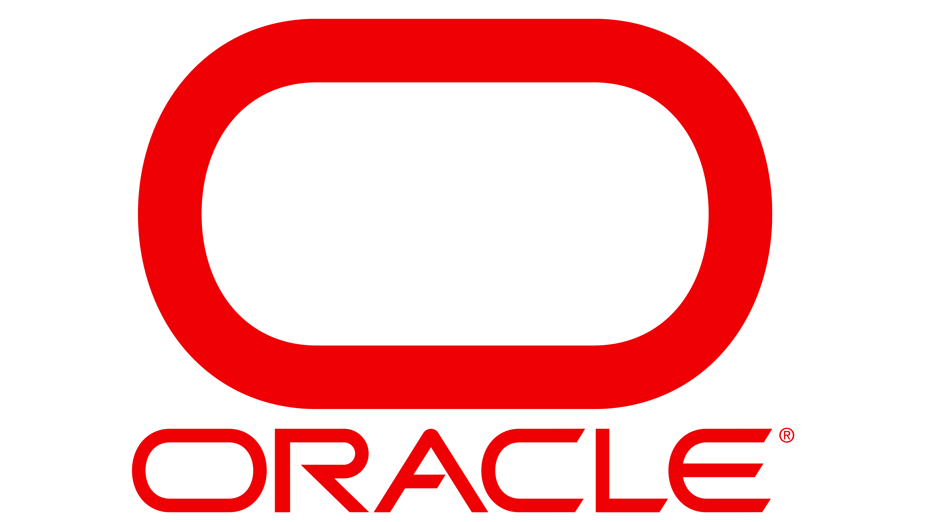
Java Implementations – Vendors
FGFGFFG
AdoptOpenJDK
Alibaba (Dragonwell)
Amazon (Corretto)
Azul (Zulu, Zing)
BellSoft (Liberica)
Red Hat (Red Hat Builds of Open JDK)
Oracle (Oracle JDK)
SAP (SapMachine)
Notes:
Non-exhaustive list
Distributers are in parentheses

Slide 41
What other languages compile to Java Bytecode?
Notes:
Now we will mention what other languages compile to Java bytecode.

Slide 42
What other Languages compile to Java bytecode?
Kotlin
Scala
Groovy
Clojure
Fantom
Ceylon
Jython
Jruby
Frege
Xtend
Golo
Concurnaas
Yeti
Notes:
There are plenty of other languages besides java that compile to Java bytecode utilizing the JVM. Listed are the top 13 JVM languages besides java:
They are :Kotlin, Scala, Groovy, Clojure, Fantom, Ceylon, Jython, Jruby, Frege, Xtend, Golo, Concurnaas, and Yeti
I will deep a little deeper into the top three highlighted languages.

Slide 43
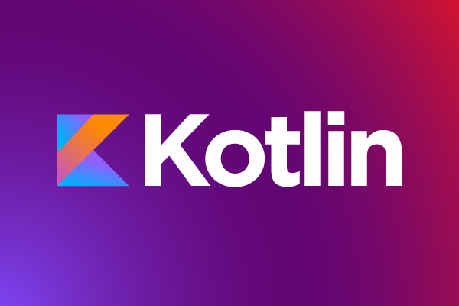
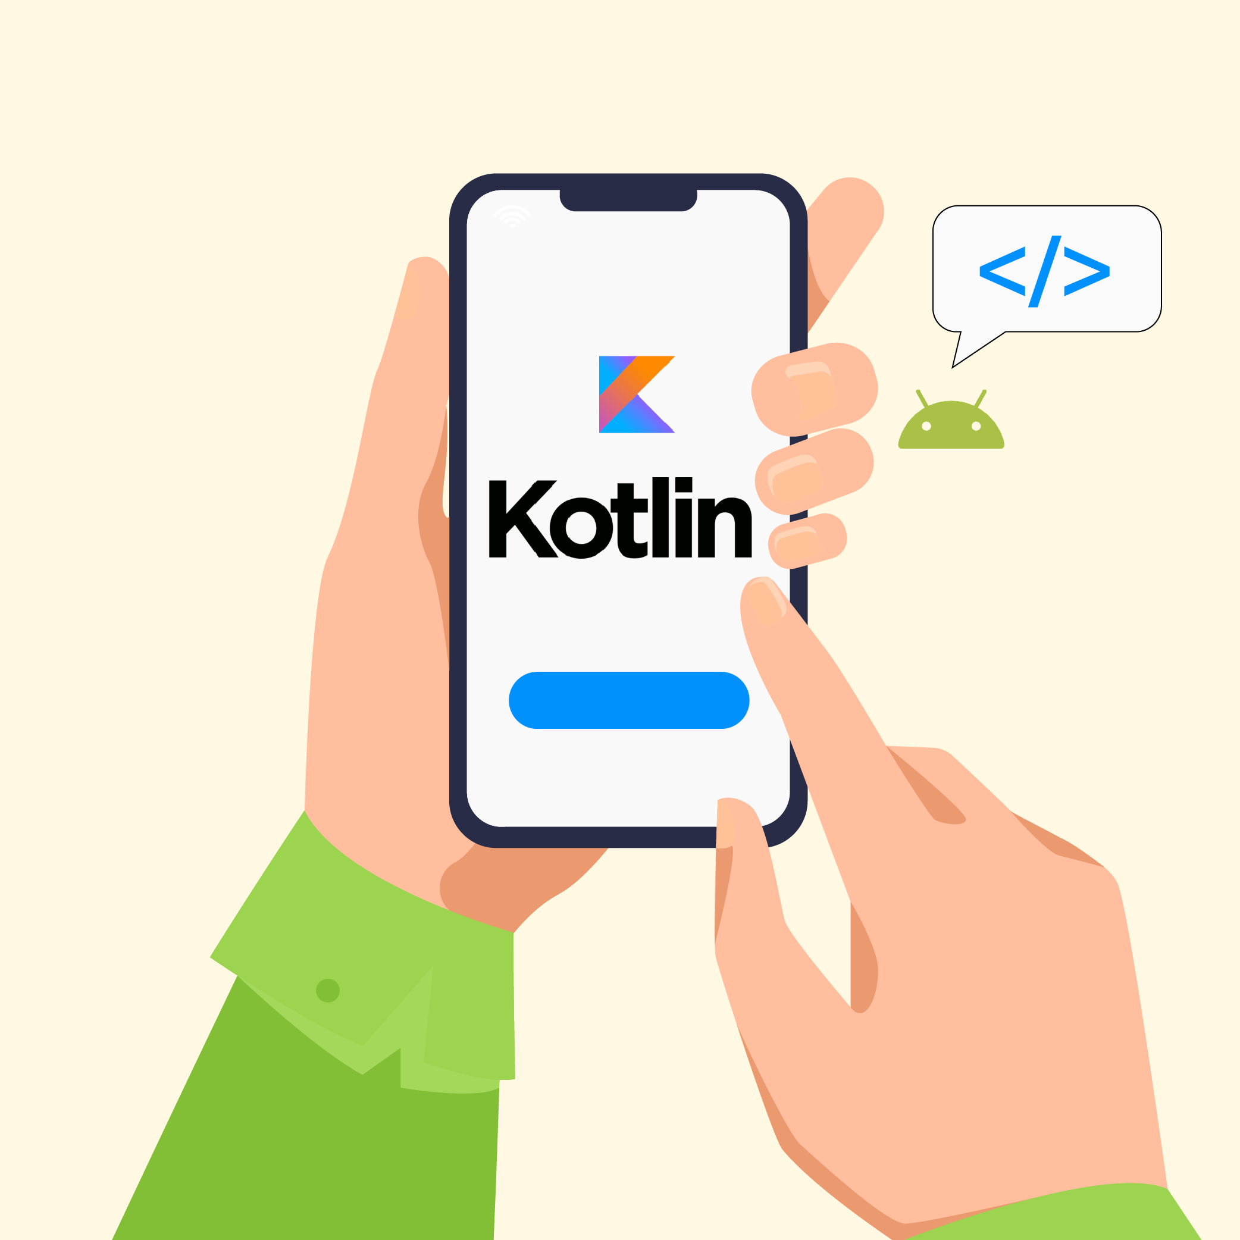
Kotlin
Main features:
Compatible with Java, Android, and web libraries
Easy to maintain and read code
Simple syntax
Strong community support
Used by the following companies:
-Google
-Pinterest
-Square
-Tinder
-Netflix
-Airbnb
Notes:
In 2017, Google made Kotlin the official language of Android. Kotlin is a popular language focused on simplifying web and mobile app development. It has a special focus on Android app development. Compared to Java, Kotlin provides more speed, faster performance, and has a simplified coding style. In app development, Kotlin reduces the number of lines of code by approximately 40% compared to Java. Kotlin provides support for different platforms including iOS, Windows, macOS, Linux, Java Script, and JVM.
One of the main reasons more developers are choosing to work with the Kotlin language is it’s easy to create and manage large applications.
It’s main features are:
Compatible with Java, Android, and web libraries
Easy to maintain and read code
Simple syntax
And finally it’s strong community support
Below are some popular companies that use Kotlin:
-Google
-Pinterest
-Square
-Tinder
-Netflix
-Airbnb

Slide 44

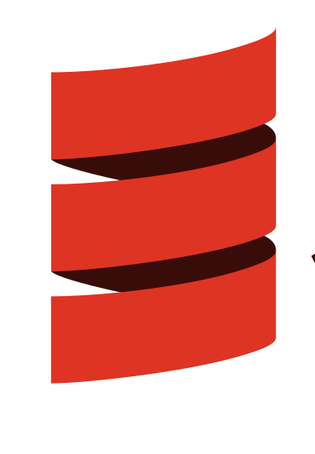
Scala
Main features:
- Scalability
- Can be used along side Java
- Easy to learn
- Concise syntax
- Provides both static and dynamic features – Avoid mistakes in code before running the program
Used by the following companies:
-Verizon
-Twitter
-Airbnb
-LinkedIn
-Coursera
Notes:
Scala is a general-purpose programming language that supports functional as well as object-oriented programming. It is a high-level language that offers static types to help decrease errors when creating complicated applications. It is highly compatible with the Java ecosystem. It is mainly utilized for data processing, web development, distributed computing and data engineering. It heavily utilizes library support. Programs written in Scala require less code than similar programs written in Java. Scala is both an object-oriented language and a functional language which makes it a good choice for web development.
It’s main features are:
- Scalability
Can be used along side Java
Easy to learn
Concise syntax
Provides both static and dynamic features – Avoid mistakes in code before running the program
Popular companies that use Scala:
-Verizon
-Twitter
-Airbnb
-LinkedIn
-Coursera

Slide 45

Groovy
Used by the following companies:
-Starbucks
-Apple
-Verizon
-Oracle
-Target
Main features:
-Flat learning curve
-Concise syntax
-Smooth Java Integration
-Static and dynamic typing
-room for opportunities as it is still growing
Notes:
The Apache Groovy language is a powerful scripting JVM language that offers simplified code and easy to learn syntax. As a dynamic, object-oriented language, it can be utilized anywhere where Java is used. It combines new applications, Java modules, and existing Java applications.
It integrates seamlessly with other Java platforms while offering strong features, meta programming, domain-specific language, and functional programming. It is easy to learn for programmers well versed in the Java programming language.
It’s main features are:
-Flat learning curve
-Concise syntax
-Smooth Java Integration
-Static and dynamic typing
-room for opportunities – still growing
Popular companies that use Groovy:
-Starbucks
-Apple
-Verizon
-Oracle
-Target

Slide 46

Android Implementation
Notes:
Next, we will discuss the android implementation

Slide 47

JVM Basics
JVM is platform dependent and different implementations are available for specific platforms.
JVM uses JIT compiler.
Java bytecode can be run on any machine capable of running JVM.
In JVM, The Java compiler converts the .java files into .class files, which is called bytecode. The javac compiler does not convert Java code directly to machine code like other compilers do.
This bytecode is given to the JVM which converts it into machine code.
Notes:
Review of the of JVM Basics
JVM is platform dependent and different implementations are available for specific platforms.
JVM uses a Just in Time compiler.
Java bytecode can be run on any machine capable of running JVM.
In JVM, The Java compiler converts the .java files into .class files, which is called bytecode. The javac compiler does not convert Java code directly to machine code like other compilers do.
This bytecode is given to the JVM which converts it into machine code.

Slide 48

Android Implementation
Java is the official programming language for Android. It would follow that Android uses the JVM?.... NOPE!
Instead of utilizing the JVM, android decided to use a different virtual machine called DVM.
Virtual Machine - convert language specific code to a format compatible to run on the Virtual Machine. The Virtual Machine enables the same code to be run on multiple different platforms regardless of the type of system.
Notes:
Java is the official programming language for Android. So it would follow that Android uses the JVM? NOPE.
Instead of utilizing the JVM, android decided to use a different virtual machine called DVM which stands for Dalvik Virtual Machine.
Why did they decide to do this? Well is comes down to the differences between JVM and the Dalvik Virtual Machine.
So what is a virtual machine? A virtual machine’s job is to convert language specific code to a format compatible to run on the Virtual Machine. The Virtual Machine enables the same code to be run on multiple different platforms regardless of the type of system.

Slide 49
DVM - Dalvik Virtual Machine Basics
JVM has high performance and provides excellent memory management, but it needed to be optimized for low-powered handheld devices. Not just regular desktop computers. That is why another Delvik Virtual Machine (DVM) was designed specifically for mobile devices.
DVM (Dalvik Virtual Machine) was created by Dan Bornstein and his team
It’s primary purpose was to create a VM that could be used on Mobile devices
Similar to the JVM, it also uses the JIT (Just in Time) compiler
Because mobile devices have limited battery life and processing and memory space, the DVM (Delvik Virtual Machine) had to be optimized to fit on low-powered devices.
Compared to the JVM, the steps used by the DVM are almost the same except the last two steps that it takes. The Dex compiler converts the class files into the .dex file that run on the Dalvik VM. Multiple class files are converted into one dex file.
Notes:
DVM - Dalvik Virtual Machine
JVM has high performance and provides excellent memory management, but it needed to be optimized for low-powered handheld devices. Not just regular desktop computers. That is why Delvik Virtual Machine (DVM) was designed specifically for mobile devices.
DVM (Dalvik Virtual Machine) was created by Dan Bornstein and his team
It’s primary purpose was to create a VM that could be used on Mobile devices
Similar to the JVM, it also uses the JIT (Just in Time) compiler
Because mobile devices have limited battery life and processing and memory space, the DVM (Delvik Virtual Machine) had to be optimized to fit on low-powered devices.
Compared to the JVM, the steps used by the DVM are almost the same except the last two steps that it takes. The Dex compiler converts the class files into the .dex file that run on the Dalvik VM. Multiple class files are converted into one dex file.

Slide 50
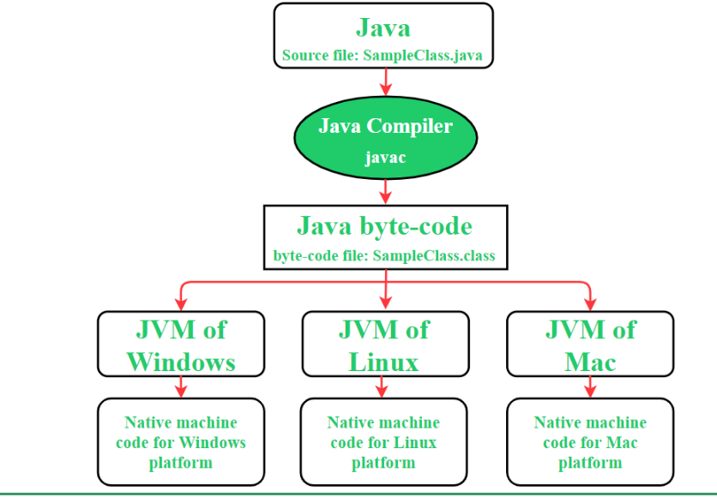
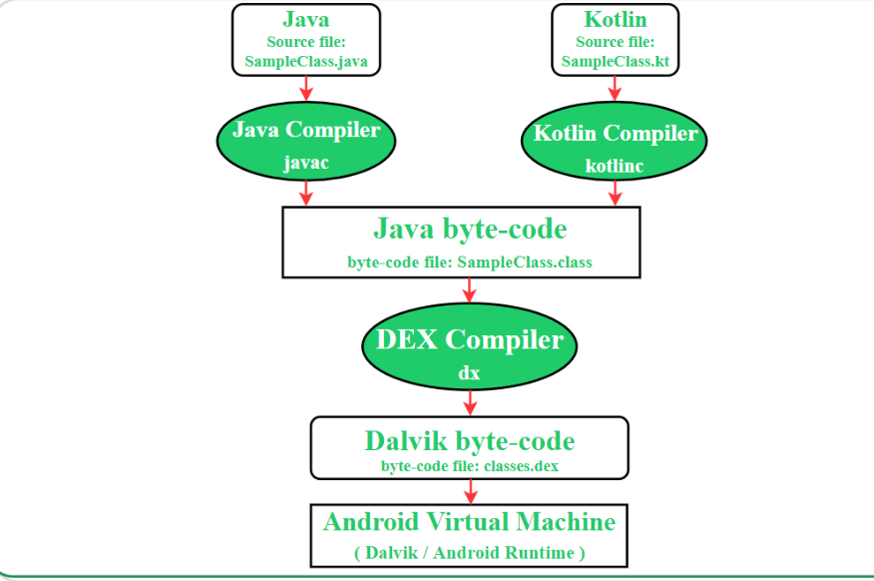
JVM versus DVM
Java Virtual Machine
Delvik Virtual Machine
Notes:
Here are the JVM and DVM steps in a side by side view.
The Java Virtual Machine first converts it’s java source file .java to the byte-code file .class, and then the Java Virtual Machine interprets it in the corresponding platform.
In the Delvik Virtual Machine, the Java source file .java is converted to the byte-code file .class, next the byte-code file is converted to Dalvike byte-code with the file name .dex. And finally the file code .apk is interpreted on the corresponding platform. Using DVM, just creates an extra step.

Slide 51
Differences between JVM and DVM
JVM(Java Virtual Machine) | DVM(Dalvik Virtual Machine)
Stack-based VM that performs arithmetic and logic operations through push and pop operands. The result of operations is stored in stack memory. | Register-based VM that uses registers located in the CPU to perform arithmetic and logic operations.
Java source code is compiled into Java bytecode format(.class file) that further translates into machine code. | Source code files are first of all compiled into Java bytecode format like JVM. Further, the DEX compiler converts the Java bytecode into Dalvik bytecode(classes.dex) file that will be used to create the .apk file. Read by DVM.
More information is required to the VM for data loading and manipulation as well as method loading in the stack data structure. | Instruction size is larger as it needs to encode the source and destination register of the VM.
Compiled bytecode size is compact. | Compiled bytecode size is larger..
The executable file for the device is .jar file. | The executable file for the device is .apk file.
A single instance of JVM is configured with shared processes and memory space in order to run all deployed applications. | The device runs multiple DVM instances with a separate process in shared memory space to deploy the code of each application.
Supports Linux, Windows, and Mac OS. | Supports only the Android operation system.
Notes:
Here are the differences between JVM and DVM in chart form.
JVM is Stack-based VM that performs arithmetic and logic operations through push and pop operands. The result of operations is stored in stack memory.
DVM is a register-based VM that uses registers located in the CPU to perform arithmetic and logic operations.
In JVM, Java source code is compiled into Java bytecode format(.class file) that further translates into machine code.
In DVM, Source code files are first of all compiled into Java bytecode format like JVM. Further, the DEX compiler converts the Java bytecode into Dalvik bytecode(classes.dex) file that will be used to create the .apk file. Read by DVM.
JVM - More information is required to the VM for data loading and manipulation as well as method loading in the stack data structure.
DVM - Instruction size is larger as it needs to encode the source and destination register of the VM.
In JVM - Compiled bytecode size is compact.
In DVM - Compiled bytecode size is larger.
The executable file for the device using JVM is .jar file.
The executable file for the device using DVM is .apk file.
A single instance of JVM is configured with shared processes and memory space in order to run all deployed applications.
The device runs multiple DVM instances with a separate process in shared memory space to deploy the code of each application.
The JVM Supports Linux, Windows, and Mac OS.
The DVM only supports Android.

Slide 52
Android deciding on DVM
DVM takes less memory, runs and loads faster compared to JVM
Though JVM is free, it was under GPL license (General Public License), which is not good for Android as most of Android is under Apache license.
JVM was designed for desktops and it is too heavy for embedded/mobile devices.
Notes:
The main reasons android decided to use DVM instead of JVM
is
DVM takes less memory, runs and loads faster compared to JVM
Though JVM is free, it was under GPL license (General Public License), which is not good for Android as most the Android is under Apache license.
JVM was designed for desktops and it is too heavy for embedded/mobile devices.

Slide 53
JIT Compiler/Execution
Notes:
I mentioned earlier something called a JIT or Just in Time compiler. I will explain a little more what that means.

Slide 54
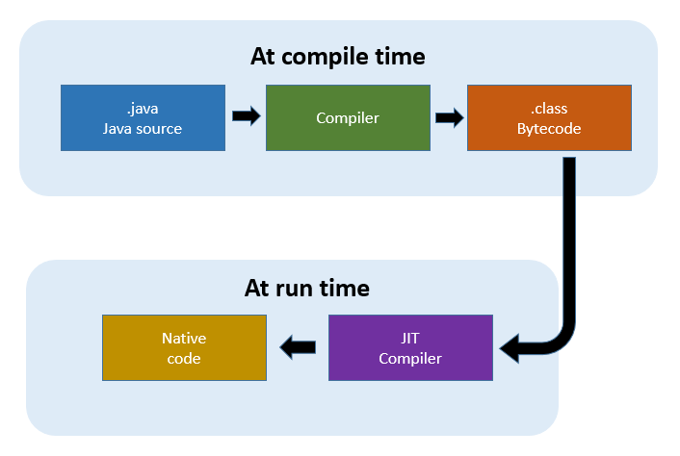
What is a JIT Compiler?
compiling bytecodes to native machine code at run time.
help the JVM start quickly and have improved performance.
For each method, the JVM maintains a count of the number of times the method is used. It starts the count at a predefined threshold value and is decreased by one every time the method is used. When the count reaches zero, a just-in-time compilation for the method is triggered.
Because of this system, the most-used methods are compiled first by the JVM and less-used methods are compiled later.
Optimization levels: cold, warm, hot, veryHot, or scorching.
Notes:
A Just-In-Time (JIT) compiler compiling bytecodes to native machine code at run time. The JIT compiler is enabled by default.
The JIT compilers help the JVM start quickly and have improved performance.
So how it works is: For each method, the JVM maintains a count of the number of times the method is used, it starts the count at a predefined threshold value and is decreased by one every time
The method is used.
When the count reaches zero, a just-in-time compilation for the method is triggered.
Because of this system, the most-used methods are compiled first by the JVM and less-used methods are compiled later.
The threshold value was selected to create a balance between startup times and long-term performance.
The JIT compiler can compile a method at different optimization levels, they are classified as: cold, warm, hot, veryHot, or scorching.
Higher/Hotter optimization levels are expected to provide better performance, but they come with a higher cost in terms of CPU and memory. The initial or default optimization level for a method is warm.
The advantages of a JIT are due to the fact, that since the compilation (com-pill-a-tion) takes place in run time, a JIT compiler has access to dynamic runtime information enabling it to make better optimizations. This means the machine code is optimized to run a specific machine’s CPU architecture.

Slide 55

Bytecode/Java performance
Logan Johansson

Slide 56
Bytecode review
Byte code is compiled Java source code which gets fed into the JVM
Opcodes are Byte-sized
Only 256 (2^8) possible opcodes, 202 currently used
Operands can be 8 or 16 bits
Total length of instruction typically 1-3 bytes long
Notes:
Byte-code is similar to Intel Assembly, but easier to read
JVM developers are hesistent to add new opcodes

Slide 57
How do we get to Bytecode?
First we must compile
Compiling will create .class file which contains bytecode
Notes:
Compiled similarly to the way gcc works, however must download JDK in WSL terminal to work with java

Slide 58
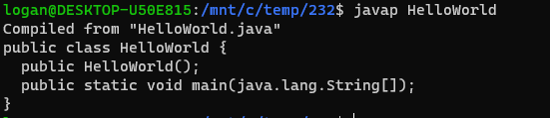
javap
javap is command for the Java file class disassembler
Notes:
De-constructed class showing methods
HelloWorld constructor added by Java

Slide 59
Javap cont.d (options)
-c
Shows the disassembled code for each of the methods of the class
-v (-verbose)
Shows stack size, number of local variables, and args for methods. Provides significantly more information about the class/program
Notes:
-c provides just the bytecode, -v provides a significant amount of information more than -c

Slide 60
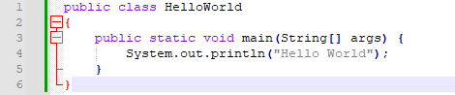
Simple Java program

Slide 61
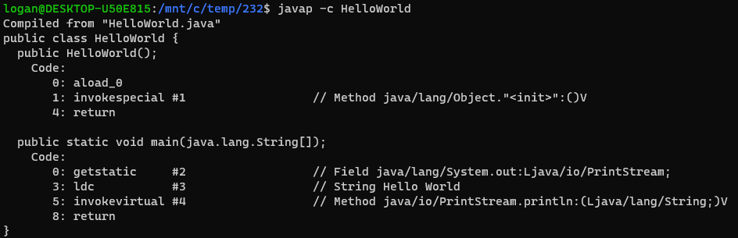
HelloWord.java Bytecode

Slide 62
HelloWord.java Bytecode
Notes:
This portion shows the bytecode for the no-args void constructor created by java.
Invokespecial is the magic of the JVM that automatically class the java/lang package, rather than importing and utilizing manually.
<init> = constructor
Returns void

Slide 63
HelloWord.java Bytecode
Notes:
Getstatic and invokevirtual function similarly to invokespecial, invokes special things the JVM does to make programming easier.
Ldc loads string onto stack
Return = return void

Slide 64
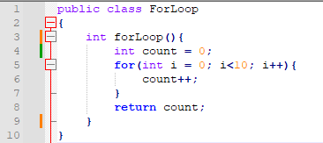
ForLoop.java
Notes:
Simple loop iterating 10 times, incrementing two variables

Slide 65
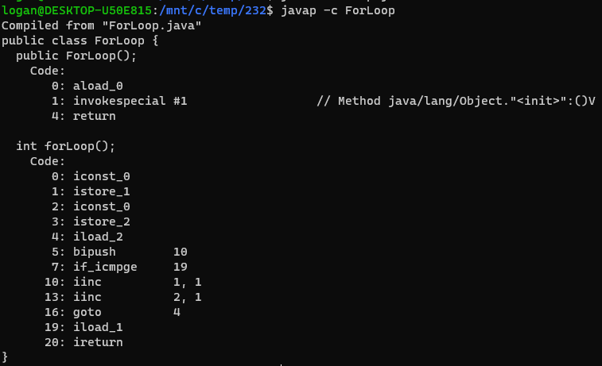
ForLoop Bytecode

Slide 66
ForLoop Bytecode
Notes:
Java operates on a stack architecture in part due to the non-machine dependent code
Two stacks created essentially:
Local variables
And the stack we will work with

Slide 67
Stack
this
0
Local Variables
Stack
Notes:
Iconst0 loads a constant onto the stack
Locals stack is indexed at 0, 0 is occupied by this pointer

Slide 68
ForLoop Bytecode
Notes:
Istore_1 pushes from stack to local variable slot 1,

Slide 69
Stack
0
this
Local Variables
Stack

Slide 70
ForLoop Bytecode

Slide 71
Stack
0
0
this
0
Local Variables
Stack
Notes:
Zero loaded and pushed onto local variable slot representing I in for loop
Top 0 = I
Middle 0 = count

Slide 72
ForLoop Bytecode
Notes:
Iload_2 loads from position 2 from locals stack, loads zero back onto stack
Bipush pushes 10 onto stack

Slide 73
Stack
0
0
this
10
0
Local Variables
Stack

Slide 74
ForLoop Bytecode
Notes:
If_icmpge is a branch opcode which will take in the two numbers on the stack. It compares the two most recent additions to the stack, in this case 0,10 and checks if 0 is greater or equal to 10. If it is, it jumps to line 19 in bytecode
If not >= it will continue through bytecode

Slide 75
Stack
0
0
this
Local Variables
Stack

Slide 76
ForLoop Bytecode
Notes:
Iinc will increment locals slot 1 by 1 and locals slot 2 by 1 and will loop to step 4 to restart the loop

Slide 77
Stack
1
1
this
Local Variables
Stack

Slide 78
ForLoop Bytecode
Notes:
The process is restarted and 1 Is loaded from locals slot 2 to the stack, followed by the bipush which again pushes 10 onto the stack.

Slide 79
Stack
1
1
this
10
1
Local Variables
Stack

Slide 80
ForLoop Bytecode
Notes:
Eventually we reach the end of the loop where count and I have been incremented to 10. The if_icmpge finds that 10 >= 10, it will jump and load locals slot 1 (count) into the stack
Ireturn returns an int value (count)

Slide 81
Stack
10
10
this
10
Local Variables
Stack

Slide 82


Performance Tradeoffs
https://www.the-sun.com/sport/7449454/brian-shaw-final-worlds-strongest-man/
https://geneticliteracyproject.org/2017/07/06/usain-bolts-asymmetrical-gait-running-unevenly-make-faster/
Notes:
Programming languages are similar to most things we find involving tradeoffs. Scratch might be easy to read and understand but it isn't quick or reliable. C is something that is extremely reliable, but isn't as intuitive as python.
Languages are designed to have different strengths and capabilities, hence the profliferation of high level languages

Slide 83
Differences between High-Level Languages
Language | Compiled vs Interpreted | Garbage Collection | Platform Independent | JVM
C | Compiled | No | No | No
C++ | Compiled | No | No | No
Java | Compiled/ Interpreted | Yes | Yes | Yes
Python | Interpreted | Yes | Yes | No

Slide 84
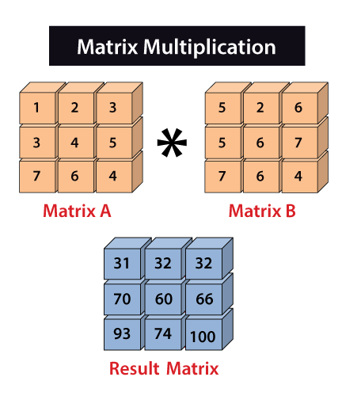
Testing Performance
Source: https://www.javatpoint.com/numpy-matrix-multiplication
Notes:
Matrix Multiplication is one of the best ways to test performance due to the sheer number of calculations needed. Matrix Multiplication is used for AI in neural nets and LLMs.

Slide 85
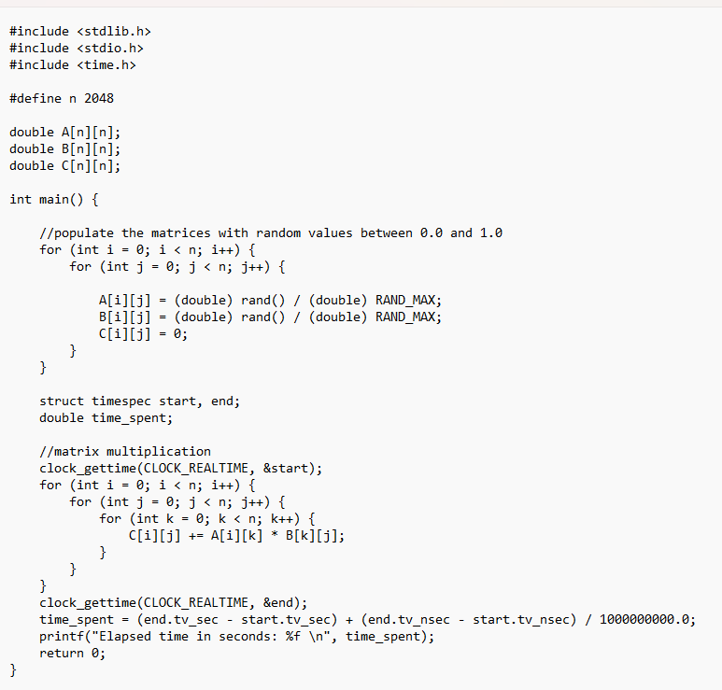
C Program
Source: https://medium.com/swlh/a-performance-comparison-between-c-java-and-python-df3890545f6d
Notes:
24 lines of code

Slide 86
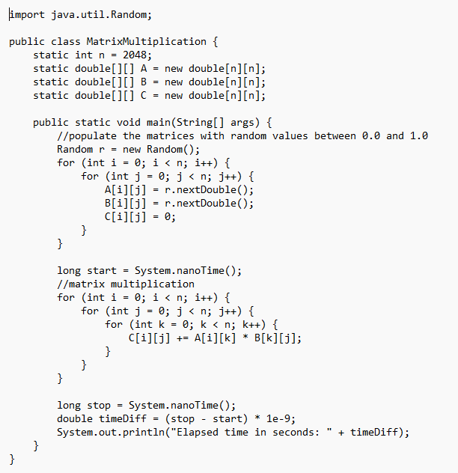
Java Program
JIT compiled vs Non-JIT
Source: https://medium.com/swlh/a-performance-comparison-between-c-java-and-python-df3890545f6d
Notes:
Java code looks similar to C code, marginally fewer lines needed
2^11 x 2^11, just over 8.5 million addition and multiplications each

Slide 87
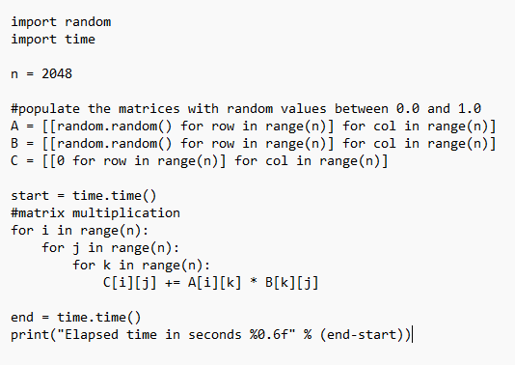
Python Program
Source: https://medium.com/swlh/a-performance-comparison-between-c-java-and-python-df3890545f6d
Notes:
13 lines, half as long as C program. Much more readable.

Slide 88
Relative Performance
 | Time (seconds) | Relative Speed Up
Python | 1792.004 | 1
C | 45.881 | 39.05
C(optimized) | 22.764 | 78.72
Java | 45.775 | 39.15
Java (without JIT) | 350.858 | 5.11
Notes:
Python is readable and easier to pick up, but is by far the slowest. C is optimized for particular machines and architectures but is extremely fast. Java is a mix between the two but shares performance similar to C, albeit slower in general
Non-JIT compilation is significantly slower, indicating that JIT has resulted in significant performance speed improvements of the Java lang.

Slide 89
Raw Performance
Python code
Unoptimized C code
-O3 Optimization flag C Code
Java JDK JIT compiled
Java interpreter only (No JIT)
Notes:
O3 is optimized for speed, WSL commands
-Xint effectively cancels any JIT compilation

Slide 90
Project Summary:
Short history of Java
Java class file structure and bytecode
Java memory Management
Java implementations – Platforms/vendors
What other languages compile to Java bytecode
Android Implementation
JIT compile/execution
Performance comparison between c/c++ and Java with and without JIT
Sample Java programs with explanation of bytecode

Slide 91
References
https://en.wikipedia.org/wiki/Java_virtual_machine
https://en.wikipedia.org/wiki/James_Gosling
https://www.bluechairgroup.com/team/mike-sheridan/
https://en.wikipedia.org/wiki/Patrick_Naughton
https://en.wikipedia.org/wiki/Acquisition_of_Sun_Microsystems_by_Oracle_Corporation
https://www.javatpoint.com/history-of-java
https://codegym.cc/groups/posts/594-history-of-java-a-full-story-of-java-development-from-1991-to-2021
https://www.geeksforgeeks.org/the-complete-history-of-java-programming-language/
https://docs.oracle.com/javase/specs/jvms/se7/html/jvms-4.html
https://en.wikipedia.org/wiki/Java_class_file

Slide 92
References
https://www.scaler.com/topics/memory-management-in-java/
https://www.digitalocean.com/community/tutorials/java-jvm-memory-model-memory-management-in-java
https://docs.oracle.com/javase/specs/jvms/se8/html/jvms-2.html
https://www.educba.com/types-of-memory-in-java/
https://www.geeksforgeeks.org/how-many-types-of-memory-areas-are-allocated-by-jvm/
https://www.geeksforgeeks.org/garbage-collection-java/
https://en.wikipedia.org/wiki/Java_(software_platform)
https://foojay.io/today/fantastic-jvms-and-where-to-find-them/
Notes:
References for topics of memory management and platforms/vendors

Slide 93
References
https://www.freecodecamp.org/news/jvm-tutorial-java-virtual-machine-architecture-explained-for-beginners/
https://www.spec-india.com/blog/jvm-languages
https://www.spec-india.com/blog/top-apps-built-with-kotlin
https://www.scala-lang.org/
https://groovy-lang.org/
https://towardsdatascience.com/jvm-vs-dvm-b257229d18a2#:~:text=One%20of%20the%20main%20reasons,and%20also%20slower%20than%20DVM.
https://medium.com/programming-lite/android-core-jvm-dvm-art-jit-aot-855039a9a8fa
https://www.geeksforgeeks.org/difference-between-jvm-and-dvm/
https://www.ibm.com/docs/en/sdk-java-technology/8?topic=reference-jit-compiler
https://www.freecodecamp.org/news/just-in-time-compilation-explained/

Slide 94
References
https://www.infoworld.com/article/3272244/what-is-the-jvm-introducing-the-java-virtual-machine.html
Kramer, Jeff (1 April 2007). "Is abstraction the key to computing?". Communications of the ACM. 50 (4): 36–42.
https://medium.com/swlh/a-performance-comparison-between-c-java-and-python-df3890545f6d
https://www.javatpoint.com/numpy-matrix-multiplication
https://www.oracle.com/java/technologies/javase/exactoptions-jsp.html
https://docs.oracle.com/javase/7/docs/technotes/tools/windows/javap.html
https://www.the-sun.com/sport/7449454/brian-shaw-final-worlds-strongest-man/
https://geneticliteracyproject.org/2017/07/06/usain-bolts-asymmetrical-gait-running-unevenly-make-faster/
https://docs.oracle.com/javase/specs/jvms/se12/html/jvms-6.html

